Slide 1
MAP 21 Performance Measures for Pavements and Bridges
Jon Wilcoxson
Division of Maintenance

Slide 2
Moving Ahead for Progress in the 21st Century (MAP-21)
Federal Surface Transportation Funding Bill
Signed into Law July 2012
Establishes a Performance-Based Program for Highways

Slide 3
Performance Based Program
Focus on National Transportation Goals
Increase Accountability and Transparency
Improve Investment Decisionmaking

Slide 4
Focus Areas for Performance
Safety
Infrastructure Condition
Congestion Reduction
System Reliability
Freight Movement and Economic Vitality
Environmental Sustainability
Reduced Project Delivery Delays

Slide 5
Focus Areas for Performance
Safety
Infrastructure Condition
Congestion Reduction
System Reliability
Freight Movement and Economic Vitality
Environmental Sustainability
Reduced Project Delivery Delays

Slide 6
Infrastructure
Pavement
Bridges
Guardrail
Signs
Signals
Striping
Pipes
Etc.

Slide 7
Infrastructure
Pavement
Bridges
Guardrail
Signs
Signals
Striping
Pipes
Etc.

Slide 8
Notice of Proposed Rulemaking (NPRM) for Pavement and Bridge Conditions
Published January 5, 2015
Establishes Required Performance Measures and Targets for National Highway System
Comment Period through May 8, 2015

Slide 9
Pavement Condition Measures
INTERSTATES | NON-INTERSTATE NHS
% of “Good” Pavements | % of “Good” Pavements
% of “Poor” Pavements | % of “Poor” Pavements

Slide 10
Required Metrics
Smoothness (IRI)
Cracking
Rutting (Asphalt)
Faulting (Concrete)

Slide 11
How are “Good” and “Poor” Defined?
 | Good | Fair | Poor
IRI (inches/mile) | <95 | 95-170 | >170
Cracking (%) | <5% | 5% - 10% | >10%
Rutting (inches) | <0.20 | 0.20 – 0.40 | >0.40
Faulting (inches) | <0.05 | 0.05 – 0.15 | >0.15

Slide 12
Determining Pavement Condition
Metric Rating Results | Overall Section Rating
All three metrics rated “Good” | Good
More than 2 metrics rated “Poor” | Poor
All other combinations | Fair

Slide 13
Required Threshold and Penalties
No more than 5% of Interstate Pavements allowed in Poor Condition
If target is not attained for two consecutive years, state must obligate funds to improve the measure.

Slide 14
Bridge Condition Measures
National Highway System
% of Bridges in “Good” Condition
% of Bridges in “Poor” Condition
% By Deck Area

Slide 15
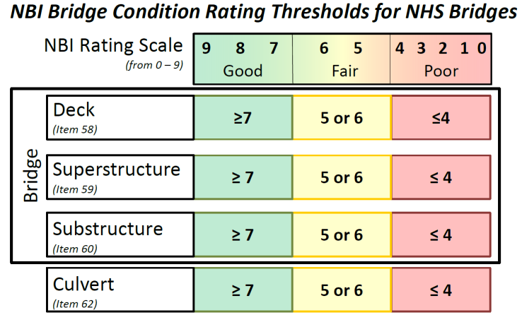

Slide 16
Determining Bridge Condition
Metric Rating Results | Overall Section Rating
All three metrics rated “Good” | Good
ANY Metric Rated“Poor” | Poor
All other combinations | Fair

Slide 17
Required Threshold and Penalties
No more than 10% of NHS Bridge Deck Area allowed in Poor Condition
If target is not attained for three consecutive years, state must obligate funds to improve the measure.

Slide 18
Potential Concerns
Extremely High Threshold for Poor Pavements on Interstate

Slide 19
 | Good | Fair | Poor
IRI (inches/mile) | <95 | 95-170 | >170
Cracking (%) | <5% | 5% - 10% | >10%
Rutting (inches) | <0.20 | 0.20 – 0.40 | >0.40
Faulting (inches) | <0.05 | 0.05 – 0.15 | >0.15

Slide 20
Potential Concerns
Extremely High Threshold for Poor Pavements on Interstate
Missing Data is Considered Poor by Default

Slide 21
Potential Concerns
Extremely High Threshold for Poor Pavements on Interstate
Missing Pavement Data is Considered Poor by Default
Forces Bridge Program to Focus on NHS
Deck Area emphasis may hurt rural areas
Replacement vs. Preservation

Slide 22
Possible KYTC-Specific Measures
Pavements
% Poor Pavements (by KYTC Definition, NHS and non-NHS)
% Good Pavements (by KYTC Definition, NHS and non-NHS)
Average Remaining Service Life (NHS and non-NHS)
Bridges
# of Substandard Bridges on State Routes
# of Structurally Deficient Bridges (entire system)
% Structurally Deficient Deck Area (entire system)

Slide 23
Questions/Comments
Comment period open until May 8, 2015

